Slide 1
What’s for breakfast
Machine Learning Algorithm to Predict Popular Breakfast Meals
Prepared By: Cindy Hui, David Phillips, Priscilla Maddela, Shelly Garg, Polina Zasheva

Slide 2
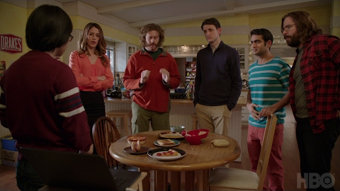
General Overview:

Slide 3
Process Outline
Download and extract Food 101 dataset
Understand dataset structure and files
Visualize random image from three of the classes
Create a subset of data with few classes*
Train the Model
Fine tune Inception Pretrained model
Predicting classes for new images from internet
Reformatted data as HDF5 to enable easier handling without compromising the model from a computational perspective
Scale up the model utilizing GitHub LFS, Flask & Keras, Tensorflow
Create a user interface that allows someone to upload an image of a food to be recognized by the machine learning algorithm

Slide 4
Multiclass Selection Model Description
Are You Hungry?
French Toast
Waffle
NOT BREAKFAST !!!
Omelet
Breakfast Burrito
Deviled Eggs
Donuts
Huevos Rancheros
Pancakes

Slide 5
Model Outline
Split the image data into train and test
Prepared “Training” dataset
Prepared “Testing” dataset
For computational efficiency, limited the dataset to 9 classes to develop the multiclass classification model
Generated separate data folders for each class
Fine tuned Inception Pretrained model
Use Keras to provide pretrained model
Using the pretrained model, we were able to use the already learned weights and add few layers on top to finetune the model to our new data
This helps in faster convergence and saves time and computation when compared to models trained from scratch
Visualized the accuracy of the model
Predicted classes for new images from internet using the best trained model
Set compile=False and clearing the session leads to faster loading of the saved model

Slide 6
Deployment
Created a directory of the model
Created a python script to build and train the model and run that script
Created directory for the Flask App
Copy the pre-trained model to the root of the Flask app
Set up virtual hosting for Flask
Create and HTML script that enables image interaction with model on app

Slide 8
Future Works
Currently our model is able to accurately predict the outcome from nine classes of food – waffles, omelet, French toast, breakfast burrito, donuts, pancakes, deviled eggs, huevos rancheros, “not breakfast food”
With more time and more computational power, we would like to add more classes to it and expand it’s usefulness by offering additional detail about each food selection– such as closes location to buy, nutritional fact, etc.
Currently our model is housed on a traditional website where the user is asked to upload an image in order to receive a response
With more time, we would like to turn this functionality into an application that enables the end user to use the camera on their phone to take a picture of a food and receive a response

